Slide 1
Web Technologies
Irshad Ullah
Department of Computer Science
COMSATS University Islamabad, Attock Campus

Slide 2
Table of contents
Rounded corners, gradients, shadows and opacity
2D/3D transforms, transitions and keyframe animations
Web fonts, icon fonts and CSS custom properties (variables)
Media and feature queries
Vendor prefixes and cross-browser compatibility

Slide 3
What is CSS3?
CSS3 is the evolution of CSS that introduced many features for creating modern and interactive web pages.
CSS3 allows developers to create rounded elements, gradients, shadows, transformations, transitions, animations, custom fonts, responsive layouts and reusable variables.
Example: .card
{
border-radius: 12px;
box-shadow: 0 5px 15px #999;
}
2

Slide 4
Rounded Corners
The border-radius property creates rounded corners.
Syntax: border-radius: 20px;
Example: .card { width: 300px; padding: 20px; border: 2px solid black; border-radius: 15px; }
Useful for cards, buttons, images, containers and forms.
Visual output
Rounded card
3

Slide 5
Different Border Radius Values
border-radius: 20px; → all corners
border-radius: 10px 20px 30px 40px; → top-left, top-right, bottom-right, bottom-left
Individual properties: border-top-left-radius, border-top-right-radius, border-bottom-right-radius, border-bottom-left-radius
4

Slide 6
Creating a Circle
A square can be turned into a circle using equal width and height with border-radius: 50%.
Example: .avatar
{
width: 100px;
height: 100px;
border-radius:
50%;
}
For a perfect circle, width and height should normally be equal.
Visual output
IMG
5

Slide 7

CSS Gradients
A gradient creates a smooth transition between two or more colors.
CSS provides linear, radial and conic gradients.
Linear example: background: linear-gradient(red, blue);
Gradients are commonly used for backgrounds, buttons, cards and visual effects.
Visual output
6

Slide 8
Linear Gradient
A linear gradient changes color along a line.
Example: background: linear-gradient(to right, red, blue);
Directions include to left, to right, to top and to bottom.
Angles can also be used: linear-gradient(45deg, red, blue).
Multiple colors are supported.
Visual output
red → yellow → green → blue
7

Slide 9
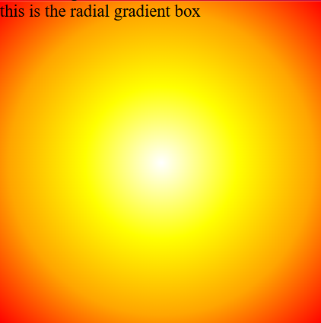
Radial Gradient
A radial gradient spreads outward from a central point.
Example: background: radial-gradient(circle, white, yellow, orange, red);
Linear gradient → color changes along a line.
Radial gradient → color spreads outward from a center.
Visual output
8

Slide 10

CSS Box Shadow
box-shadow adds a shadow around an element.
Syntax: box-shadow: x-offset y-offset blur spread color;
Example: box-shadow: 0 10px 20px gray;
Common uses: cards, buttons, navigation bars, modals and images.
Visual output
9
Notes:
X-offset: Horizontal distance
Y-offset: Vertical distance

Slide 11
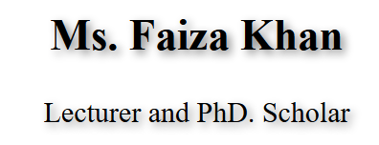
Text Shadow
text-shadow adds a shadow to text.
Example: h1
{
text-shadow: 2px 2px 5px gray;
}
box-shadow → shadow around an element.
text-shadow → shadow around text.
Visual output
10

Slide 12
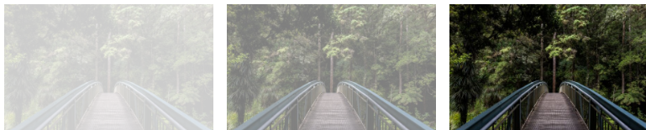
Opacity
opacity controls how transparent an element is.
0 → completely transparent
1 → completely visible
Example: img { opacity: 0.5; }
An opacity of 0.5 makes the element 50% opaque.
Visual output
opacity 0.2 opacity 0.5 opacity 1(default)
11

Slide 13

CSS Transform
The transform property changes the appearance or position of an element without changing the normal document flow.
Common transformations: translate(), rotate(), scale(), skew().
Example: .box { transform: rotate(20deg); }
Visual output
12

Slide 14
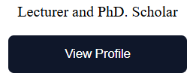
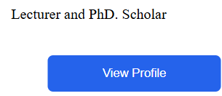
Translate
translate() moves an element.
Example: transform: translate(50px, 20px);
translateX(50px) → horizontal movement.
translateY(20px) → vertical movement.
Example: .box:hover { transform: translateY(-5px); }
Visual output
13
Notes:
upword

Slide 15
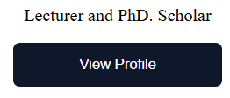
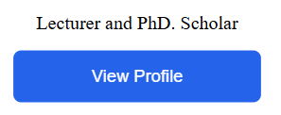
Scale
scale() changes the size of an element.
1 → original size
1.2 → 120% of original size
0.5 → 50% of original size
Example: img:hover { transform: scale(1.1); }
Visual output
14

Slide 16

Skew
skew() slants an element.
Example: transform: skew(20deg);
skewX(20deg) → slant along X axis.
skewY(20deg) → slant along Y axis.
Visual output
16

Slide 17
2D vs 3D Transform
2D transformations mainly use the X and Y axes.
Examples: translate(), rotate(), scale(), skew().
3D transformations add the Z axis.
Examples: translateZ(), rotateX(), rotateY(), rotateZ().
Visual output
2D: X ↔ Y ↕
3D: X ↔ Y ↕ Z ⊙
17

Slide 18
3D Transform Example
Example: .card:hover { transform: rotateY(180deg); }
This rotates the card around the Y-axis.
3D effects often work together with perspective.
Example: .container { perspective: 500px; }
18
Notes:
how deep or realistic a 3D effect looks by setting the distance between the viewer's eye and the Z=0 plane.
The value you provide is a length (usually in pixels). Think of it as how close you are standing to the object:

Slide 19
CSS Transition
A transition creates a smooth change between two CSS states.
Without transition → the change happens immediately.
With transition → the change happens gradually.
Example: button {
background: black;
transition: 0.3s;
}
button: hover {
background: blue;
}
19

Slide 20
Transition Properties
transition-property → property being animated
transition-duration → length of the transition
transition-timing-function → speed pattern
transition-delay → waiting time before the transition
Shorthand: transition: background 0.3s ease;
Common timing functions: ease, linear, ease-in, ease-out, ease-in-out.
20

Slide 21
Transform + Transition
A common modern UI effect combines transform and transition.
Example: .button { transition: all 0.2s ease; }
.button:hover { transform: translateY(-2px); }
Transition controls how smoothly the transform occurs.
21
Notes:
Move upwrod

Slide 22
CSS Keyframe Animation
CSS animations allow an element to change through multiple stages.
They use @keyframes.
@keyframes mymove {
from {top: 0px;}
to {top: 200px;}
}
div {
width: 100px;
height: 100px;
background: red;
position: relative;
animation: mymove 2s infinite;
}
<h1>The @keyframes Rule</h1>
<div>i am moving</div>
22

Slide 23
Animation Properties
An animation lets an element gradually change from one style to another.
To use CSS animation, you must specify some keyframes for the animation.
Important properties include animation-name, animation-duration, animation-delay, animation-iteration-count, animation-direction and animation-timing-function.
Example: .box {
animation-name: move;
animation-duration: 2s;
animation-iteration-count: infinite;
}
23

Slide 24
Multiple Keyframes
Animations can use percentages instead of only from and to.
Example: 0% → start, 50% → move, 100% → return.
This allows multi-step motion and more complex effects.
Visual output
0% 50% 100%
□ → ■ → □
24

Slide 25
Transition vs Animation
Transition usually requires a state change such as :hover.
Animation can run automatically using @keyframes.
Transform changes the visual state; transition makes a change smooth; animation defines multiple stages over time.
Visual output
Transition: hover
Animation: automatic
25

Slide 26
Web Fonts
Web fonts allow websites to use fonts that may not be installed on the user's computer.
@font-face defines a web font.
Example: @font-face {
font-family: MyFont;
src: url('myfont.woff2');
}
P{
font-family: MyFont;
}
Then use it with: body { font-family: MyFont; }
26

Slide 27
Font Formats
Common web font formats include WOFF, WOFF2, TTF and OTF.
WOFF2 is commonly preferred for modern websites because of efficient compression and broad modern browser support.
.woff2 .woff .ttf .otf
27
Notes:
Web open font format, True type font format, Open type font

Slide 28
Icon Fonts
Icon fonts represent icons using font characters.
Examples include Font Awesome and Material Icons.
Icons can be resized and recolored using CSS.
Example concept: <i class='icon-home'></i>
<head>
<script src="https://kit.fontawesome.com/a076d05399.js" crossorigin="anonymous"></script>
</head>
<body>
<i class="fas fa-cloud"></i>
<i class="fas fa-heart"></i>
<i class="fas fa-car"></i>
<i class="fas fa-file"></i>
<i class="fas fa-bars"></i>
</body>
</html>
Visual output
28

Slide 29
CSS Custom Properties
Also known as CSS variables
Allow you to store specific values in one place and reuse them.
When you define CSS variables
To define a custom property, name it starting with two dashes (--).
To use it, wrap the variable name inside the var() function
inside: root, they are generally available throughout the entire webpage.
Example:
:root { --primary-color: #2563eb; }
Use with:
button {
background: var(--primary-color);
}
Visual output
Button
29

Slide 30
Why Use CSS Variables?
Without variables, the same color or value may be repeated throughout the stylesheet.
With variables, define the value once and reuse it.
If the value changes, update the variable rather than every individual rule.
This improves consistency and maintainability.
Change once → updates everywhere
30

Slide 31
Media Queries
Media queries apply different CSS depending on characteristics of the viewport or device.
They are commonly used for responsive web design.
Example: @media (max-width: 600px) { .profile-card { width: 100%; } }
Visual output
Desktop → Mobile
wide card → full-width card
31

Slide 32
Responsive Design
Visual output
A responsive website adapts its layout to different screen sizes.
Desktop may display multiple cards in a row.
Mobile may stack cards vertically.
Media queries help create these layout changes.
DESKTOP
[Card] [Card] [Card]
MOBILE
[Card]
[Card]
[Card]
32

Slide 33
Media Query Syntax
CSS media queries allow you to apply styles based on the characteristics of a device or the environment displaying the web page.
The CSS @media rule is used to add media queries to your style sheet.
General syntax: @media media-type and (condition) { /* CSS rules */ }
Example: @media screen and (max-width: 768px) { body { font-size: 14px; } }
Common conditions: max-width, min-width, max-height, min-height and orientation.
Visual output
≤ 768px → mobile styles
33

Slide 34
Feature Queries
Visual output
Feature queries use @supports.
They check whether the browser supports a particular CSS feature.
Example: @supports (display: grid) { .container { display: grid; } }
They can be used to provide fallbacks for newer CSS features.
Supports Grid? YES → Grid
NO → Fallback
34

Slide 35
Why Use @supports?
Visual output
A fallback can be provided when a browser does not support a modern feature.
Example: .container { display: block; }
Then: @supports (display: grid) { .container { display: grid; } }
The browser uses Grid when supported and the fallback otherwise.
Modern browser → Grid
Older browser → Block
35

Slide 36
Vendor Prefixes
Vendor prefixes were used to add new experimental or browser-specific CSS features.
Examples: -webkit-, -moz-, -ms-, -o-
Example: -webkit-transform: rotate(20deg); transform: rotate(20deg);
Prefixes are less necessary for many modern CSS features.
Visual output
-webkit- -moz-
-ms- -o-
36

Slide 37
Are Vendor Prefixes Still Necessary?
Not usually for most modern CSS features.
Modern browsers support many CSS properties without prefixes.
Prefixes may still appear in legacy code or be relevant for certain experimental features.
Do not automatically add prefixes to every CSS property.
Visual output
Modern CSS
transform: rotate(20deg);
37

Slide 38
Cross-Browser Compatibility
A website should work correctly across browsers such as Chrome, Firefox, Edge and Safari.
Browsers can differ in CSS feature support, rendering and default styles.
Developers should test important interfaces across target browsers.
Visual output
Chrome Firefox Edge Safari
✓ ✓ ✓ ✓
38

Slide 39
How to Improve Compatibility?
Visual output
Use standard CSS.
Check browser compatibility.
Provide fallbacks where appropriate.
Use feature queries when useful.
Test websites in multiple browsers.
Use responsive design and avoid unnecessary experimental features.
Standard CSS + Fallback + Test
39

Slide 40
CSS3 Features: Quick Review
Visual output
Visual effects: border-radius, gradients, box-shadow, text-shadow, opacity
Transformations: translate, rotate, scale, skew, 3D transforms
Motion: transition, @keyframes, animation
Modern CSS: web fonts, icon fonts, CSS variables
Responsiveness and compatibility: @media, @supports, vendor prefixes, cross-browser testing
Effects | Motion | Fonts | Responsive | Compatibility
40

Slide 41
Key Concepts to Remember
Visual output
Transform = what changes.
Transition = how smoothly it changes.
Animation = how it changes through multiple stages.
Media query = when different CSS should apply based on viewport/device conditions.
Feature query = whether the browser supports a CSS feature.
Transform = change
Transition = smooth change
Animation = multiple stages
41

